Slide 1

Networking IT & Infrastructure
Assignment Presentation

Slide 2


OUR PROPOSAL
This proposal is for a data communication network and it aims to serve a small start-up Interior Design Firm - YDC Interior.

Slide 3


Network Needs Analysis
The basis for the Network Needs Analysis is based on the extended knowledge that the network system is for an Interior Design company in its early stages of operations.

Slide 4
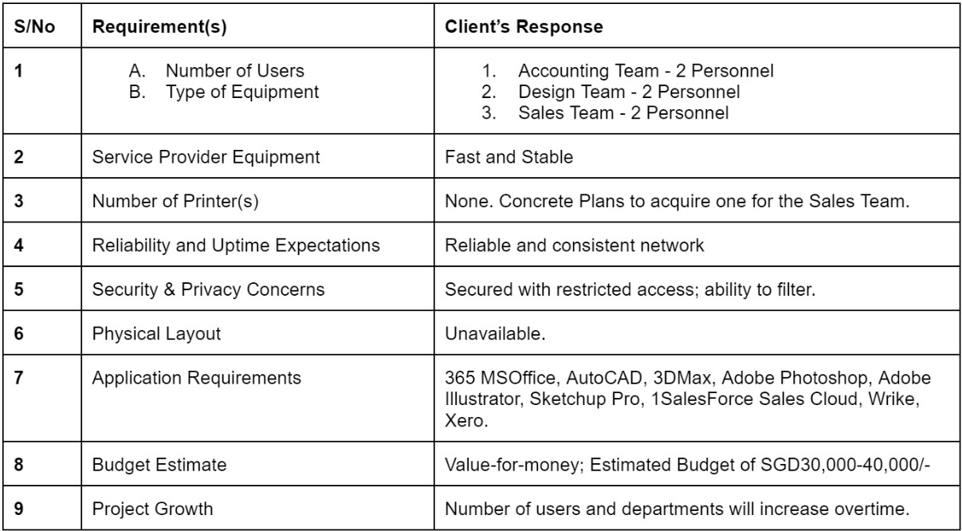
Figure 1.0 Table of Requirement

Slide 5
NETWORK ANALYSIS
FUNCTIONABILITY
NETWORK SCALABILITY
INTENDED USER
- Integration and updates are to be effortless and versatile.
- Enables users to retrieve, process and store ASCII & non-ASCII text, different media mediums.
- Scalable design: More departments & devices can be added as the business expands.
- Combine power capabilities & of diverse equipment across the office space.
Sales Team
Accounting Team
Design Team

Slide 6
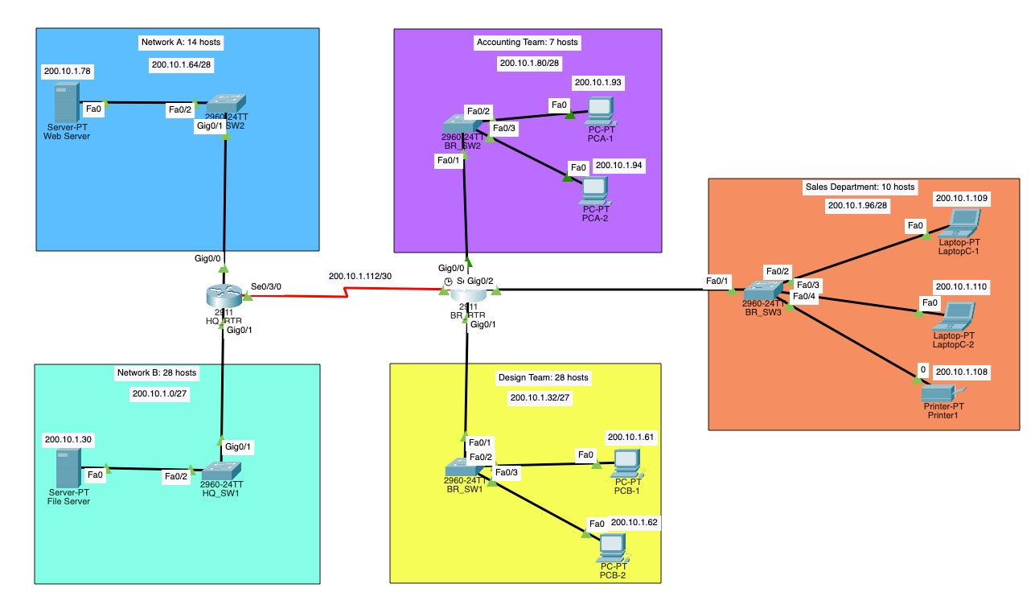
Design of the Network Diagram simulated on Packet Tracer

Slide 7
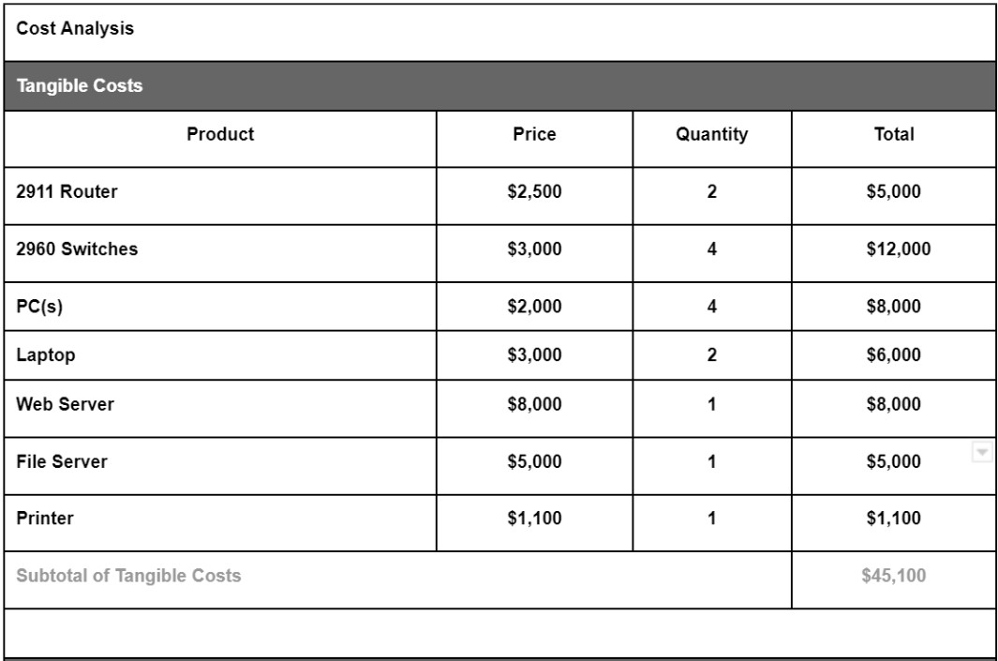
Cost Benefit Analysis (CBA)

Slide 8
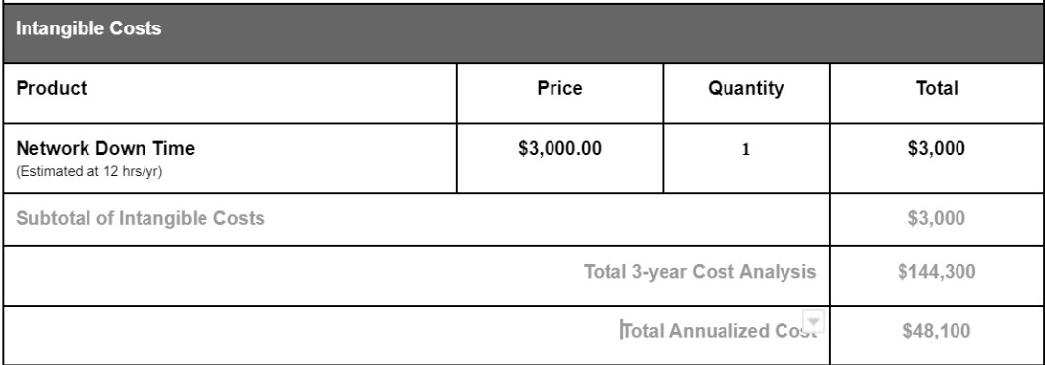
Cost Benefit Analysis (CBA)

Slide 9
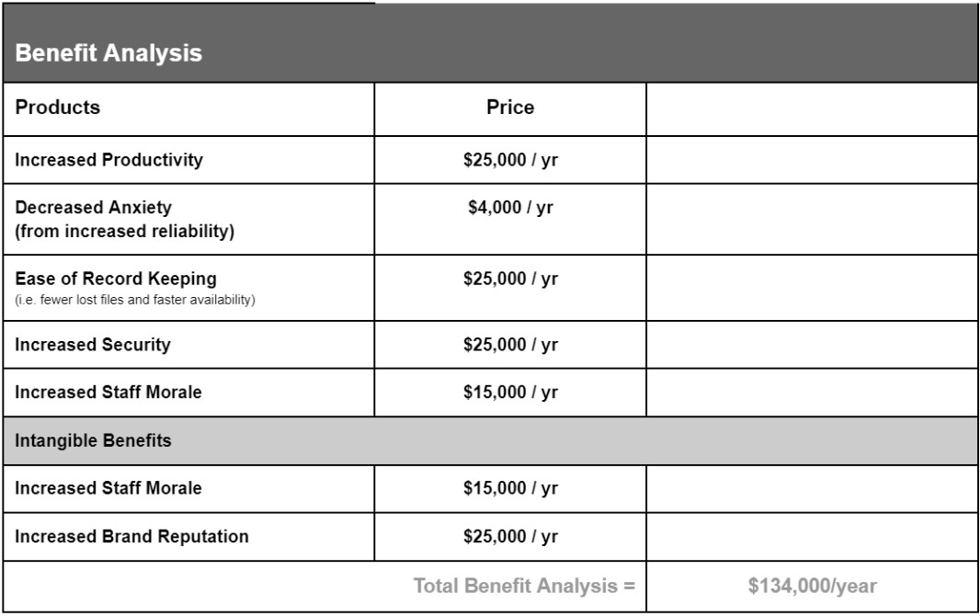
Benefit Analysis (BA)

Slide 10
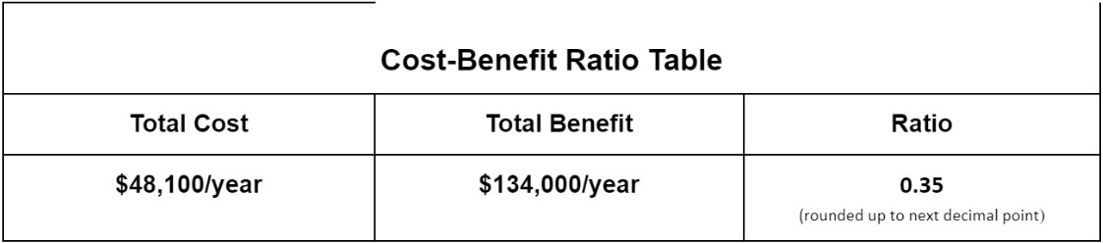
Cost-Benefit Ratio

Slide 11
Conclusion
underlying uncertainties may still be needed to address such as the basis of number of devices
Any questions?

Slide 12
Fonts & colors used
This presentation has been made using the following fonts:
Montserrat
(https://fonts.google.com/specimen/Montserrat?query=mont)
Open Sans
(https://fonts.google.com/specimen/Open+Sans?query=open)
#ffb711
#000000
#f3f3f3
#d9d9d9

Slide 13


